Slide 1
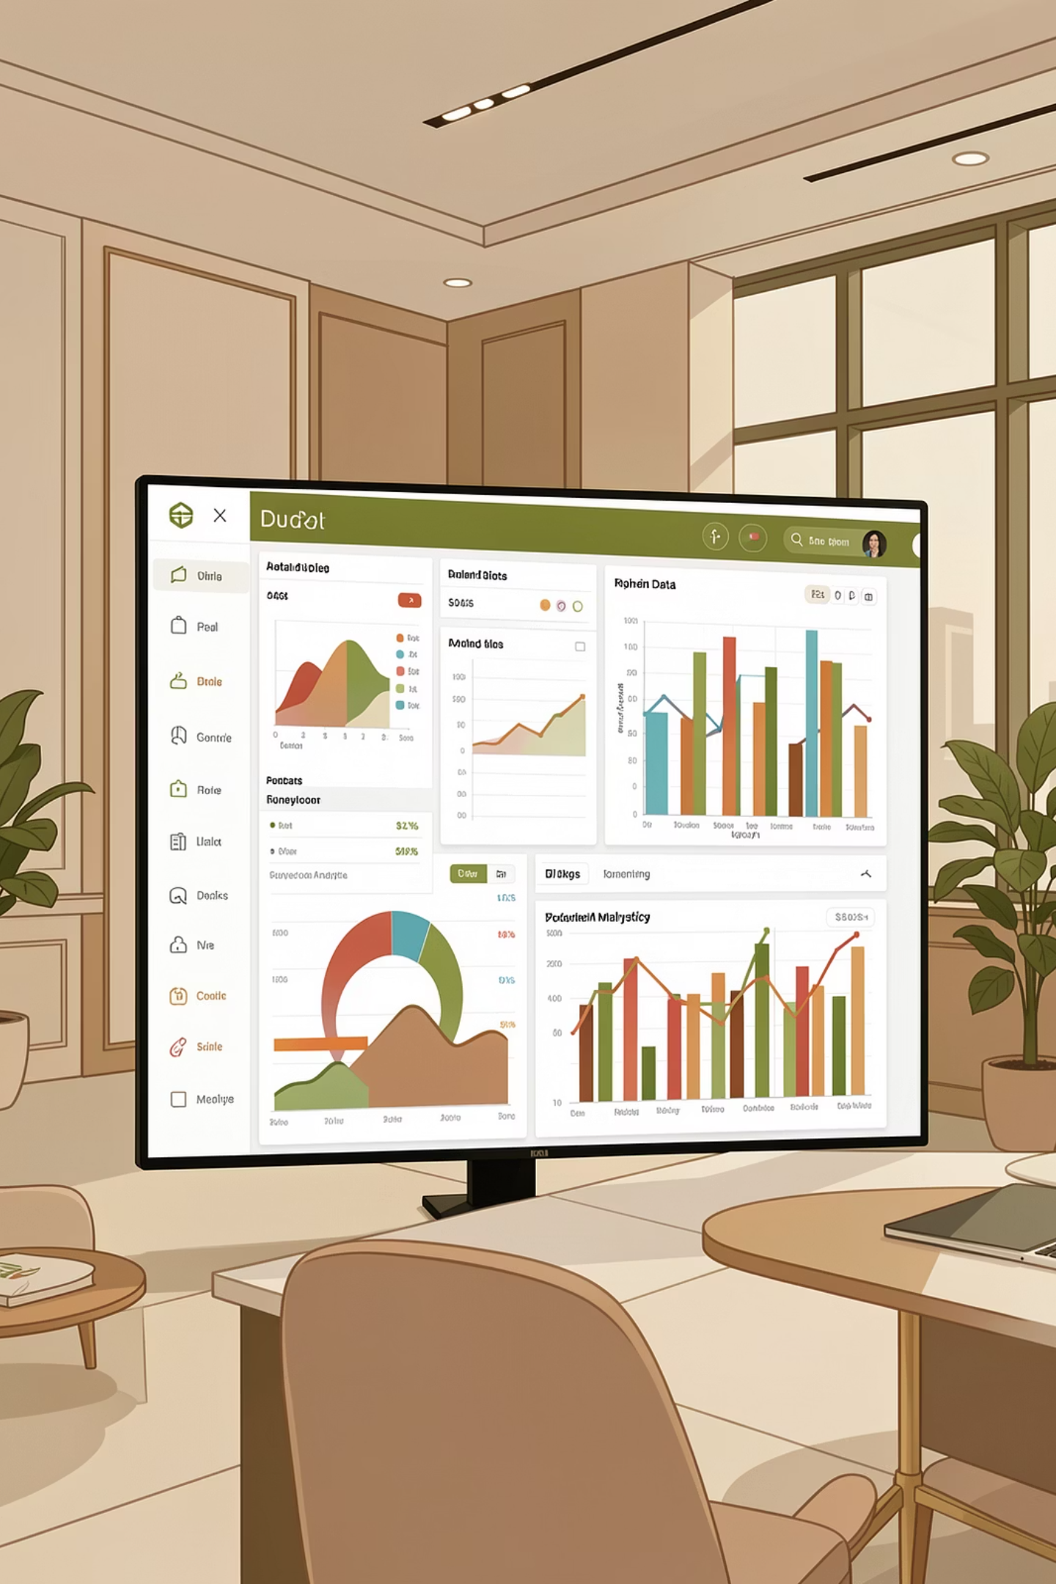
Customer Shopping Behavior Analysis
Uncovering insights from 3,900 purchases to drive strategic decisions

Slide 2

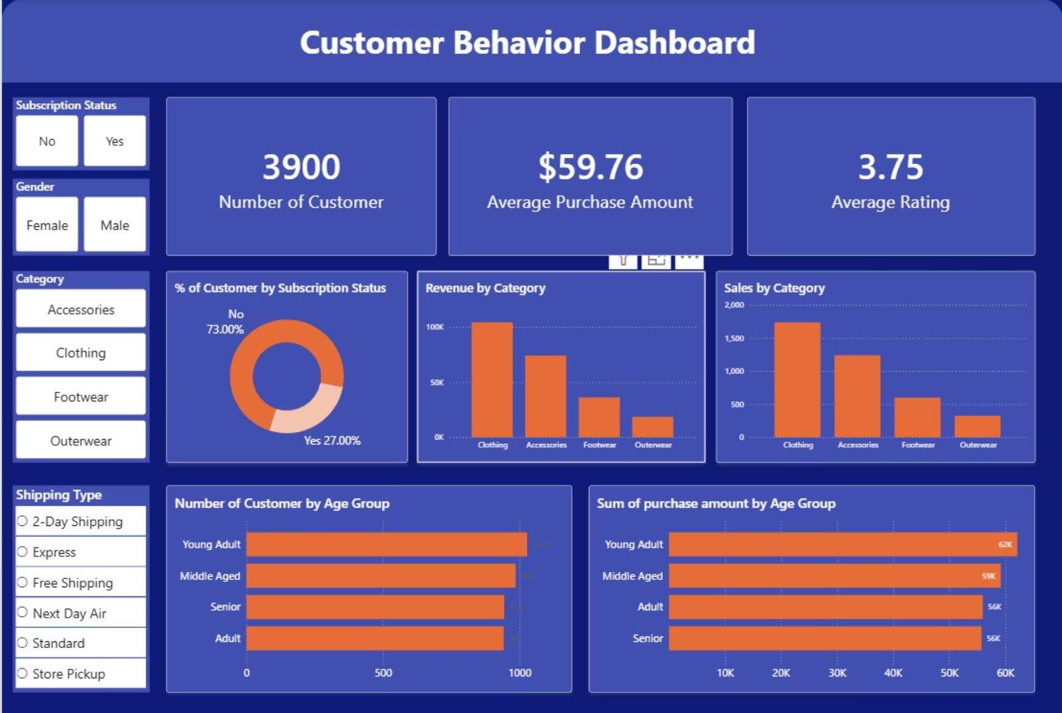
DATASET OVERVIEW
The Foundation
3.9K
18
4
Total Purchases
Data Points
Categories
Transactions analyzed
Features per customer
Product segments
Key Features Tracked
Customer demographics & location
Purchase details & spending patterns
Shopping behavior & preferences
Subscription & loyalty metrics

Slide 3
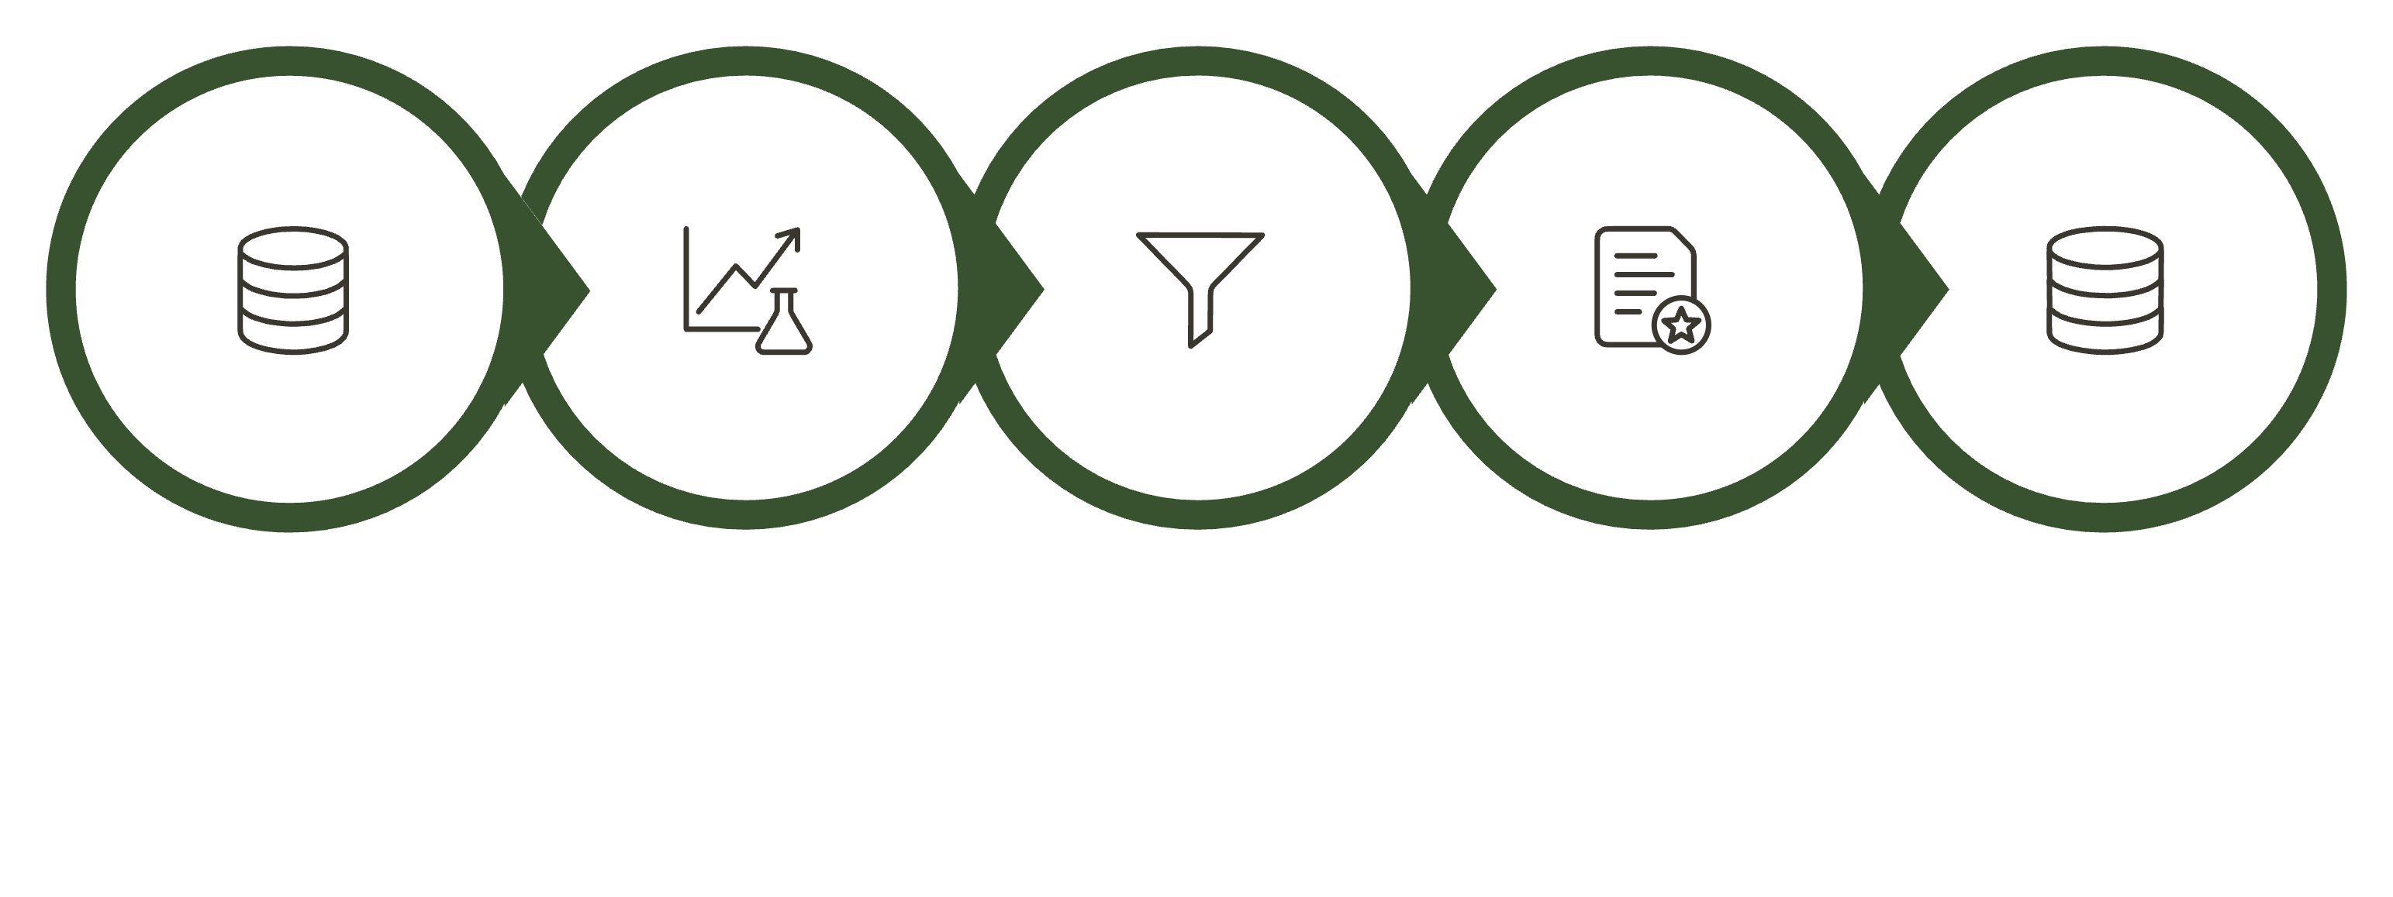
DATA PREPARATION
Python Analysis Pipeline
Load Data
Explore & Clean
Handle Missing Values
Engineer Features
Export to Database
Systematic approach to transform raw data into actionable insights
Missing Data
New Features
Optimization
37 values imputed using median ratings
Age groups & purchase frequency created
Redundant columns removed for clarity

Slide 4
SQL ANALYSIS
10 Key Business Questions
01
02
Revenue by Gender
High-Spending Discount Users
03
04
Top-Rated Products
Shipping Type Impact
05
06
Subscriber Behavior
Discount Dependency
07
08
Customer Segmentation
Category Leaders
09
10
Repeat Buyer Patterns
Age Group Revenue

Slide 5
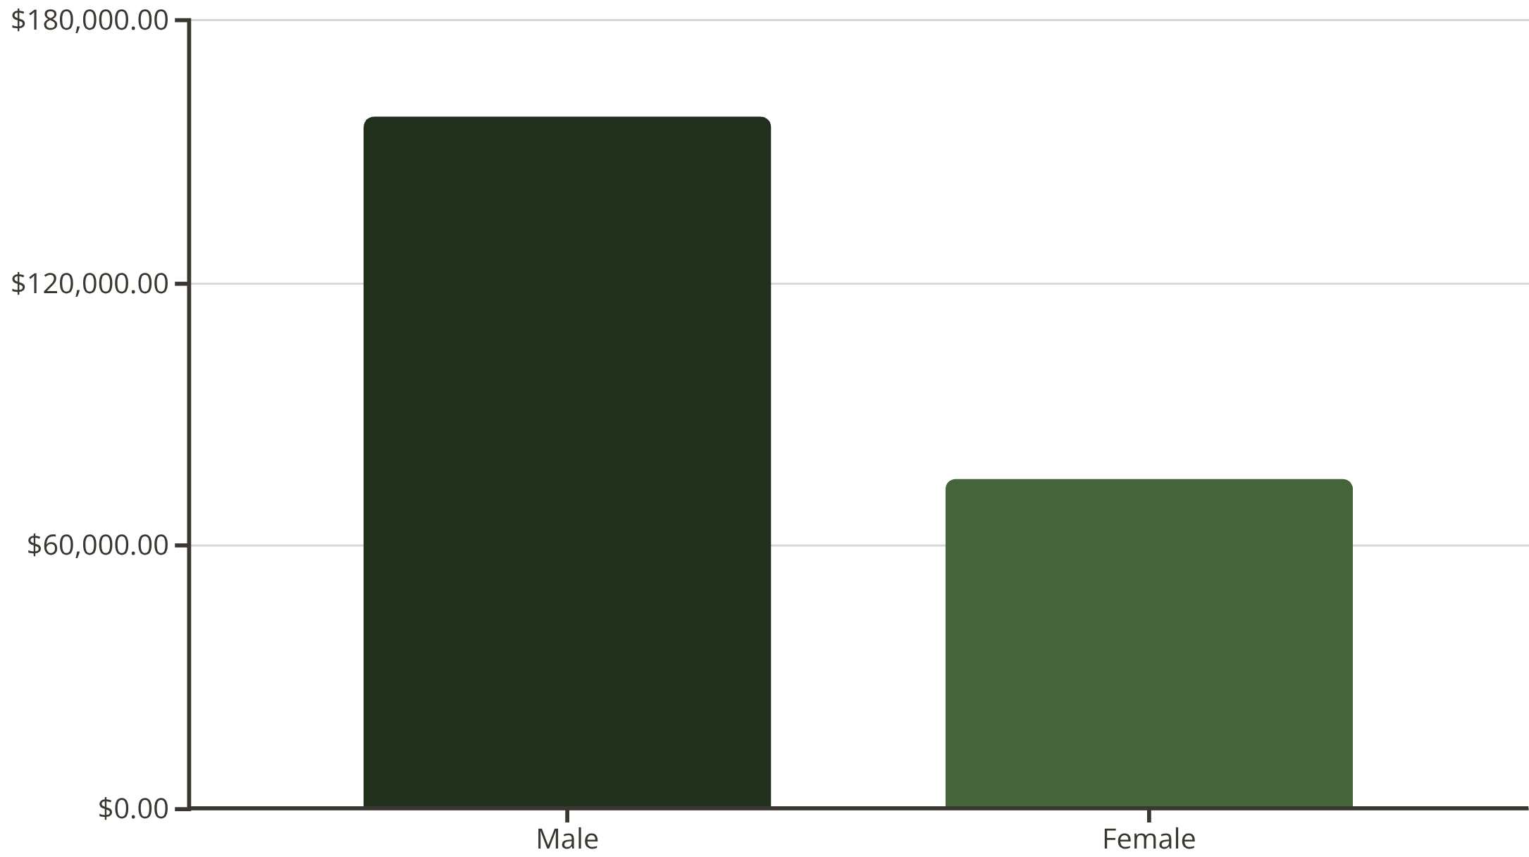
Revenue Insights
Gender Revenue Gap
Male customers generate 2.1x more revenue than female customers, representing 68% of total sales.
839 Customers
Used discounts but spent above average

Slide 6




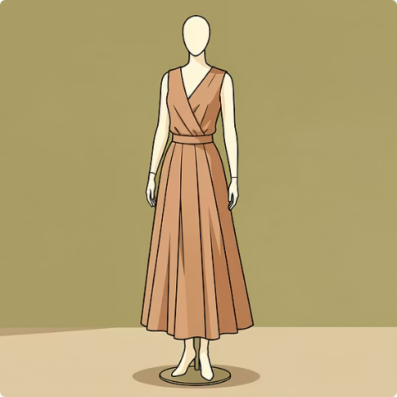
PRODUCT PERFORMANCE
Top-Rated Products
Gloves
Sandals
Boots
Hat
3.86 rating
3.84 rating
3.82 rating
3.80 rating
Skirt
3.78 rating

Slide 7
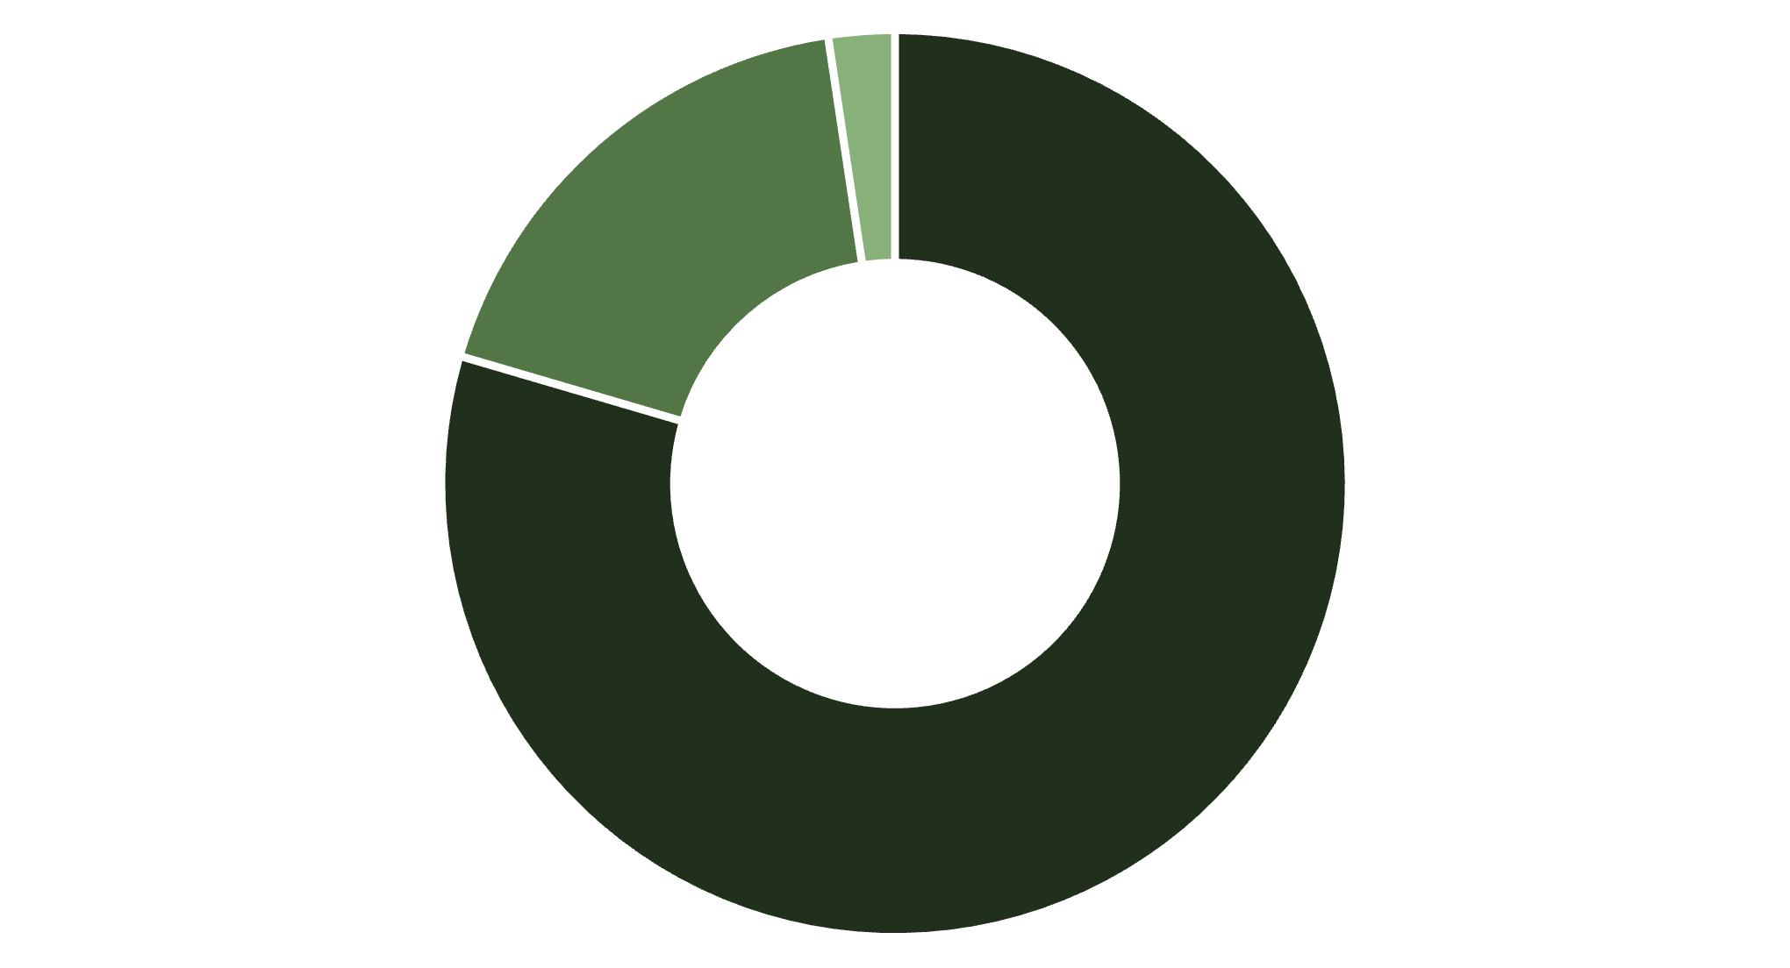


Customer Segmentation
Loyal
Returning
New
Loyalty Dominates
80% of customers are loyal buyers, showing strong retention.
27%
73%
Subscribers
Non-Subscribers
Subscription rate: $59.49 avg spend vs $59.87 non-subscribers

Slide 8
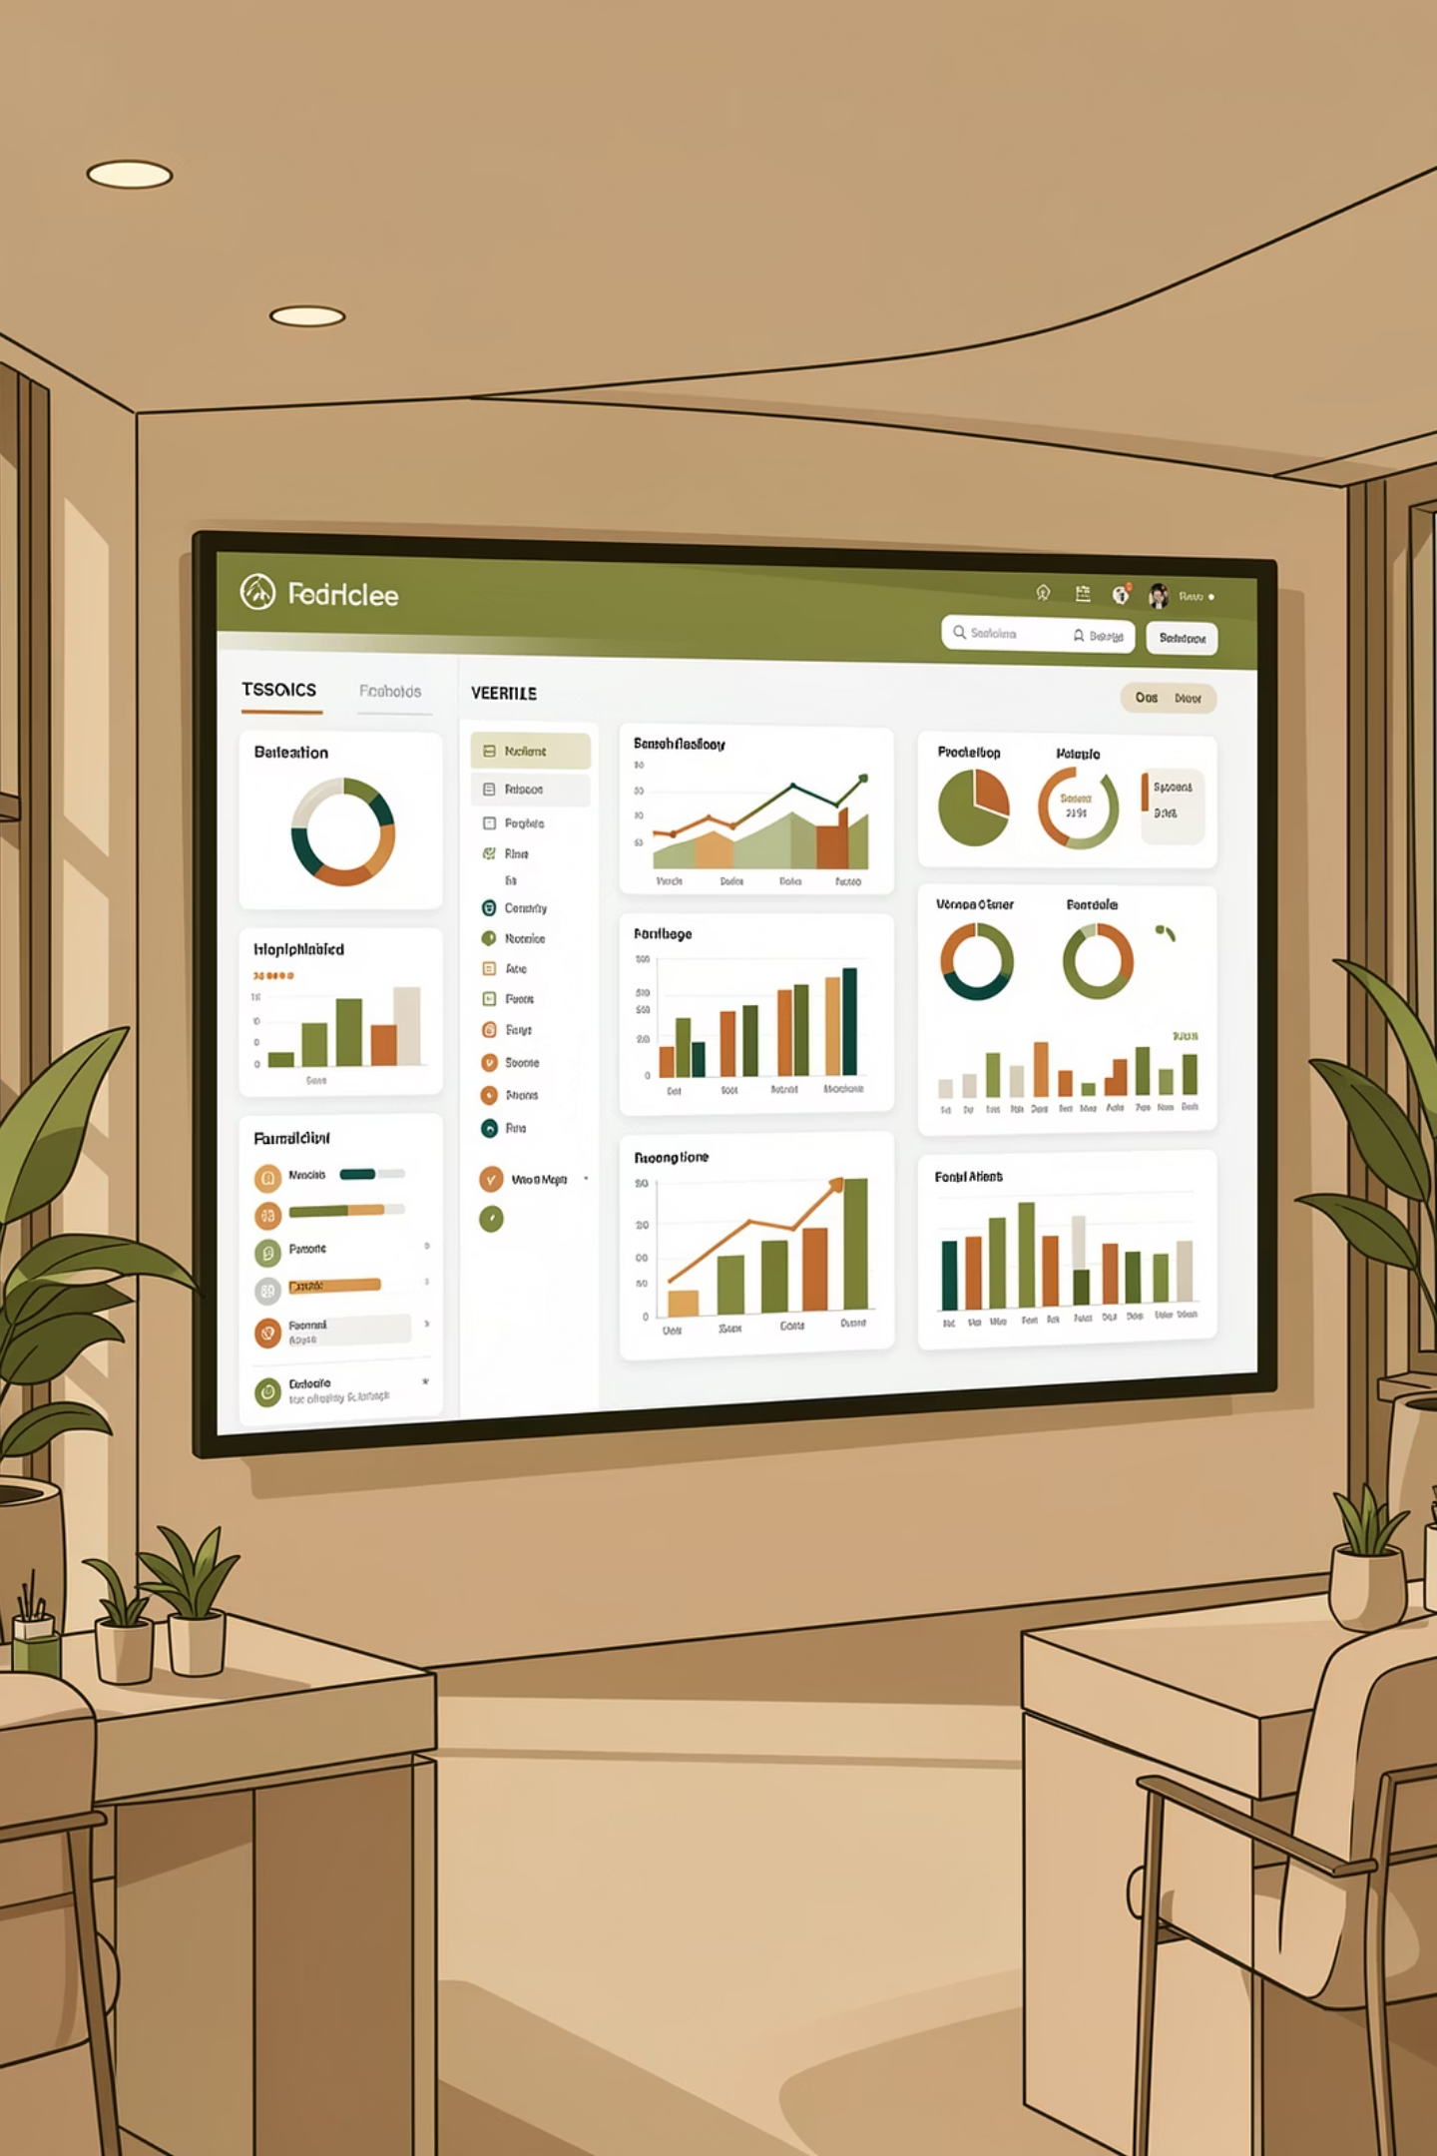
POWER BI DASHBOARD
Visual Intelligence
Clothing Leads
Young Adults
Express Shipping
Highest revenue at $45K
$100K revenue, 1,800 sales
$60.48 avg vs $58.46 standard

Slide 9



STRATEGIC RECOMMENDATIONS
Action Plan
Boost Subscriptions
Loyalty Programs
Smart Discounting
Promote exclusive benefits to convert the 73% non-subscribers
Reward repeat buyers to strengthen the 80% loyal base
Balance promotions with margin control—50% of hats sold with discounts

Slide 10

Next Steps
Focus Areas
Highlight top-rated products in marketing campaigns
Target young adults and express-shipping users
Convert loyal customers into subscribers
Optimize discount strategy by product category
Target high-revenue segments for maximum impact
$59.76
3.75
80%
Avg Purchase
Avg Rating
Loyal Customers

